Slide 1
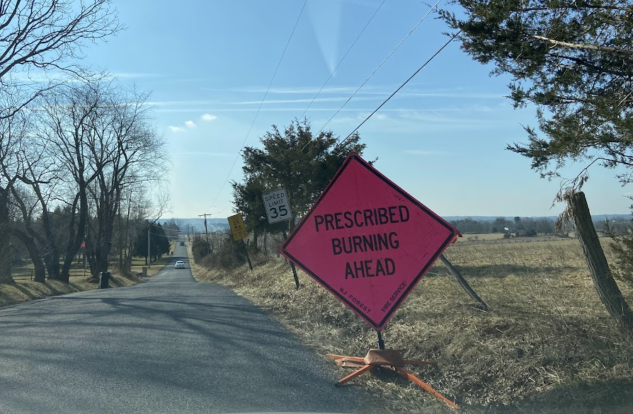
NJ Forest Fire Service will conduct a prescribed burn at Cider Mill Grassland Preserve in East Amwell on Monday, December 8, 2025, weather permitting.

